Slide 1
Equals vs ==

Slide 2
Equals vs ==
Most languages have two ways to compare variables for equality
Value types:
== & Equals return true if values are equal (but using == is more common)
Reference types:
== compares object references → are these the same objects?
Equals compares values → do these objects have the same values?
Exceptions:
string is a reference type with value type semantics in other words == is implement based on string value comparison
Object.Equals behaves as == by default

Slide 3
Equals vs ==
Equals is a method that can be overridden by subclasses:
Which Equals implementation is chosen is based on polymorphism, specific object type at runtime
== is an operator that can be overloaded by classes:
Which == operator definition is chosen is based on compile time type
int, bool, float, etc → ==
objects → references → ==, values → Equals
strings → == is usually safe, Equals also works ☺

Slide 4
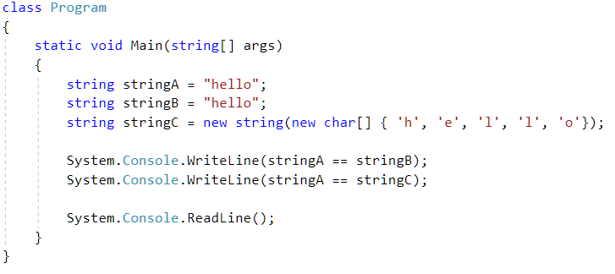
What does this print?
Output:
True
True

Slide 5

What does this print?
Output:
True
False

Slide 6
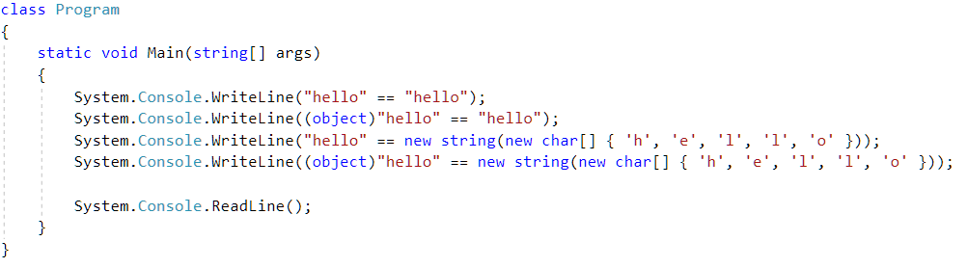

What does this print?
Output:
True
True
True
False

Slide 7
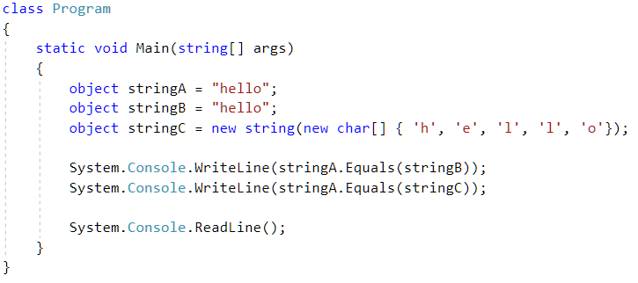
What does this print?
Output:
True
True

Slide 8

What does this print?
Output:
False
False

Slide 9

What does this print?
Output:
False
True

Slide 10
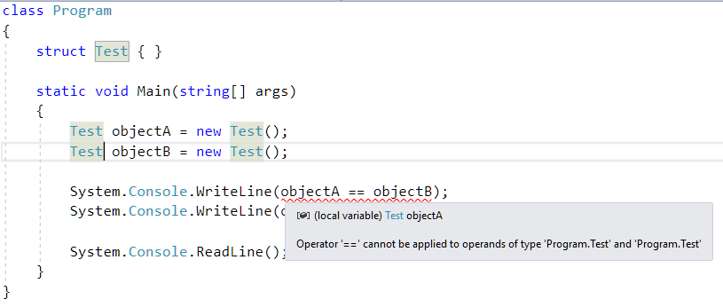
What does this print?

Slide 11
Equals vs ==
Moral of the story, in theory:
== → references (shallow comparison)
Equals →
By default by value (deep comparison) for structs
By default by reference (shallow comparison) for classes
== can be overloaded, Equals can be overridden
There are some weird exceptions to the general rules based on compile type declarations / struct vs classes
Main thing: be aware of these two comparison methods and that you might be using the wrong one

Slide 12
List.IndexOf / Contains revisited

Slide 13
List.IndexOf and List.Contains
Lecture 2 recap, pseudocode:
The equals in the pseudo code is actually implemented using Equals, not == (This also means you can override Equals and wreak havoc on your list ☺)
List.Contains (item) pseudo:
return List.IndexOf (item) > -1
List.IndexOf (item) pseudocode*:
for (int i = 0; i < Count;++i) {
if internalArray[i] equals item return i;
}
return -1;

Slide 14
All the dirty details
https://stackoverflow.com/questions/814878/c-sharp-difference-between-and-equals
https://blogs.msdn.microsoft.com/ericlippert/2009/04/09/double-your-dispatch-double-your-fun/
https://devblogs.microsoft.com/csharpfaq/when-should-i-use-and-when-should-i-use-equals/
https://coding.abel.nu/2014/09/net-and-equals/
https://docs.microsoft.com/en-us/previous-versions/ms173147(v=vs.90)
https://medium.com/@equisept/c-journey-into-struct-equality-comparison-deep-dive-9693f74562f1

